Slide 1
DDS – For Live Session Unit 2
Andrew Leppla
*See Notes section below slides for R code

Slide 2
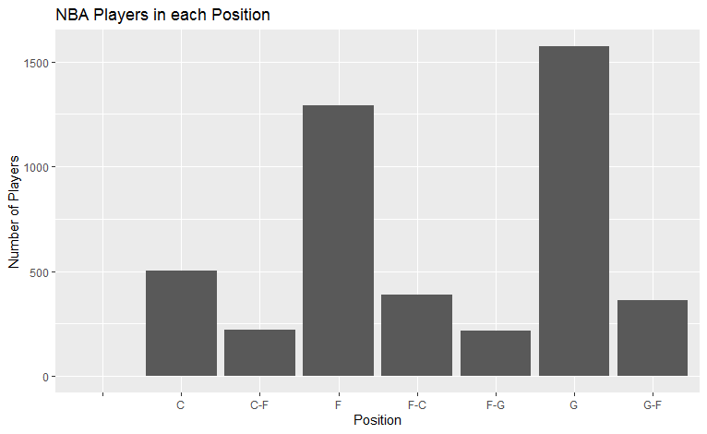
Problem - Use the PlayerBBall.csv dataset to visually represent (summarize) the number of players in each position.
Notes:
library(ggplot2, magrittr)
bball = read.csv('C:/Users/aleppla/Documents/Andy - Personal/MS DataSci/MSDS 6306 - Doing Data Science/Unit 2/PlayersBBall.csv')
bball %>% ggplot(aes(x=position)) + geom_bar() + ggtitle("NBA Players in each Position") + ylab("Number of Players") + xlab("Position")

Slide 3
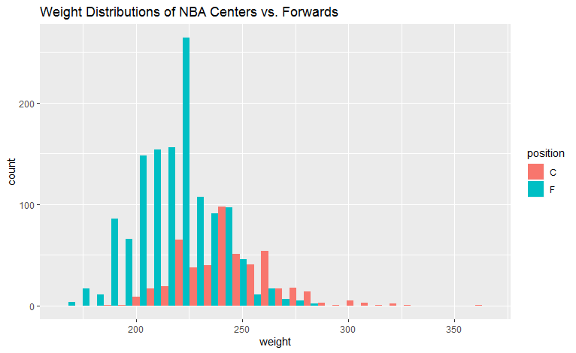
Centers appear to have a marginally greater weight distribution than Forwards in the NBA, but this is likely not significant due to the major overlap in the distributions
Notes:
#Attempt just using ggplot, can't get “dodge” to work, used facet_wrap for side-by-side instead
ggplot() + geom_histogram(data=bball[bball$position=="C",], aes(x=weight,fill="Center")) +
geom_histogram(data=bball[bball$position=="F",], aes(x=weight,fill="Forward")) + facet_wrap(~position)
#Subsetting and recombining data frames for C and F. Can now use “dodge” to overlay side-by-side
C = bball[bball$position=="C",]
Fw = bball[bball$position=="F",]
C_Fw=rbind(C,Fw)
C_Fw %>% ggplot(aes(x=weight, fill=position)) + geom_histogram(position="dodge") + ggtitle("Weight Distributions of NBA Centers vs. Forwards")

Slide 4
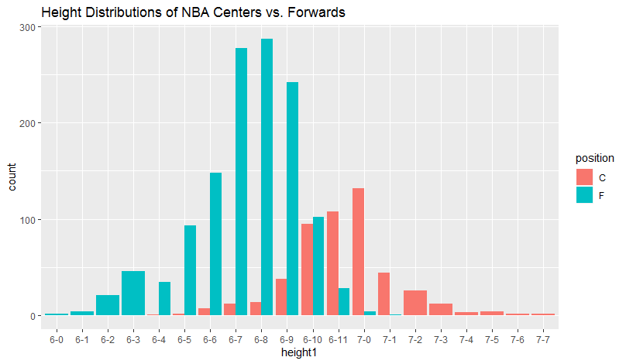
Centers appear to have a greater height distribution than Forwards in the NBA, although there is some overlap between them.
Notes:
#Need to reorder the height factor levels with -10, -11 to go after -9 instead of -1
##https://www.r-bloggers.com/reorder-factor-levels/
levels(bball$height)
bball$height1=factor(bball$height, levels(bball$height)[c(1,4:9,2:3,10:11,14:21,12:13,22:29)])
levels(bball$height1)
C = bball[bball$position=="C",]
Fw = bball[bball$position=="F",]
C_Fw=rbind(C,Fw)
C_Fw %>% ggplot(aes(x=height1, fill=position)) + geom_bar(position="dodge") + ggtitle("Height Distributions of NBA Centers vs. Forwards")

Slide 5
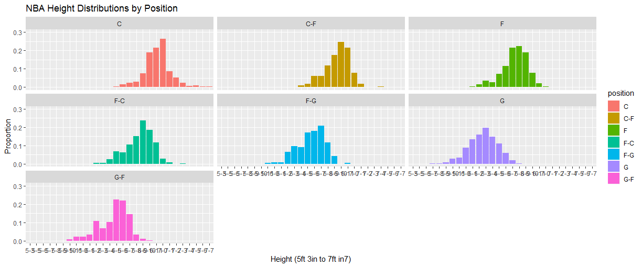
Height distributions appear to be different for some positions in the NBA. The shortest are Guards and the tallest are Centers, as expected.
Notes:
bball[bball$position!="",] %>% ggplot(aes(x=height1, y=..prop.., group=1, fill=position)) + geom_bar() +
facet_wrap(~position) + coord_cartesian(ylim = c(0, 0.3)) + ggtitle("NBA Height Distributions by Position") +
xlab("Height (5ft 3in to 7ft 7in)") + ylab("Proportion")

Slide 6
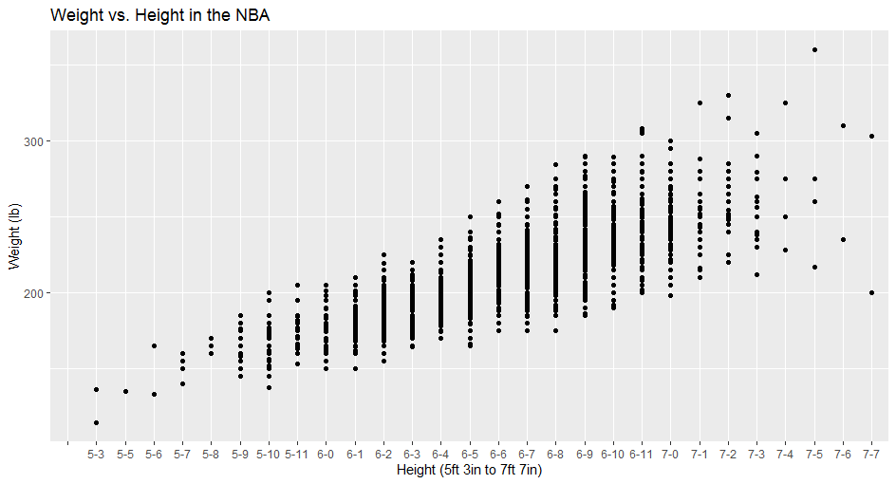
Weight and height are positively correlated – as height increases, weight increases, and vice versa
Notes:
bball %>% ggplot(aes(x=height1, y=weight)) + geom_point() + ggtitle("Weight vs. Height in the NBA") +
xlab("Height (5ft 3in to 7ft 7in)") + ylab("Weight (lb)")

Slide 7
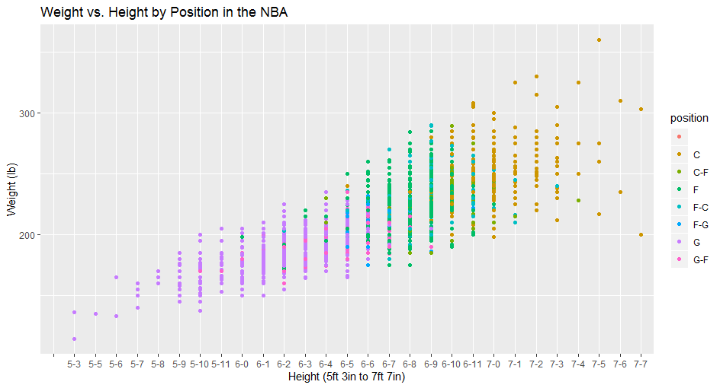
Centers do not follow the weight vs. height trend (flatter line)
Notes:
bball %>% ggplot(aes(x=height1, y=weight, color=position)) + geom_point() + ggtitle("Weight vs. Height by Position in the NBA") +
xlab("Height (5ft 3in to 7ft 7in)") + ylab("Weight (lb)")

Slide 8
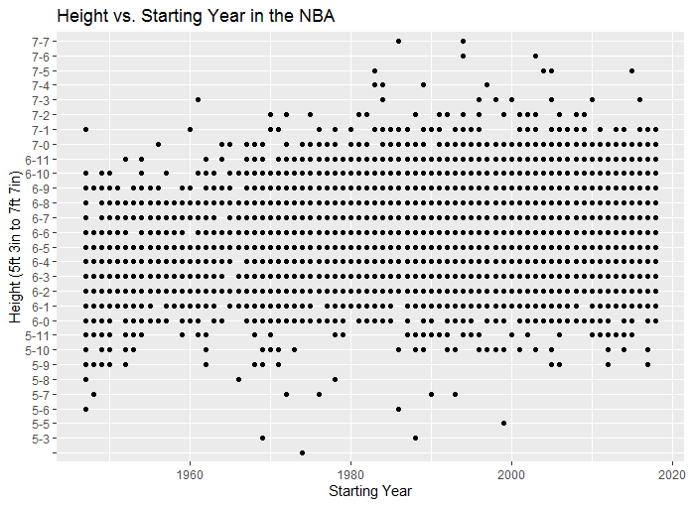
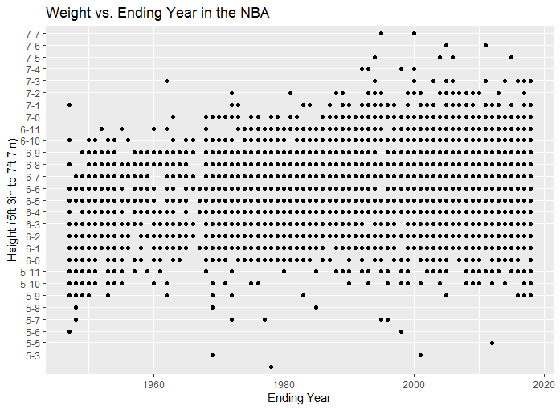
No evidence to suggest that NBA players are getting taller over time
Notes:
bball %>% ggplot(aes(x=height1, y=year_start)) + geom_point() + ggtitle("Height vs. Starting Year in the NBA") +
xlab("Height (5ft 3in to 7ft 7in)") + ylab("Starting Year") + coord_flip()
bball %>% ggplot(aes(x=height1, y=year_end)) + geom_point() + ggtitle("Weight vs. Ending Year in the NBA") +
xlab("Height (5ft 3in to 7ft 7in)") + ylab("Ending Year") + coord_flip()

Slide 9
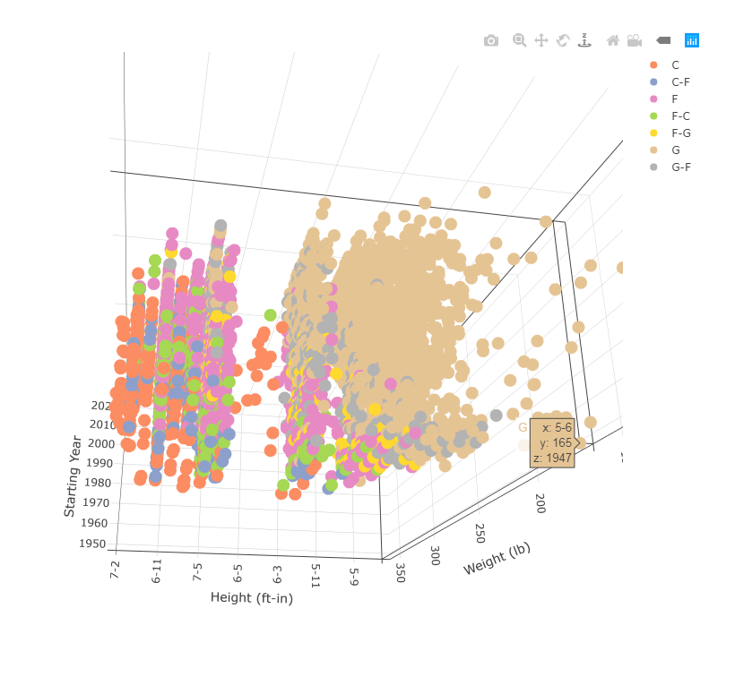
Create a 3D plot of height vs. weight vs. year and color code the points by position.
Notes:
p <- plot_ly(bball, x = ~height1, y = ~weight, z = ~year_start, color = ~position) %>%
add_markers() %>%
layout(scene = list(xaxis = list(title = 'Height (ft-in)'),
yaxis = list(title = 'Weight (lb)'),
zaxis = list(title = 'Starting Year')))
p

Slide 10
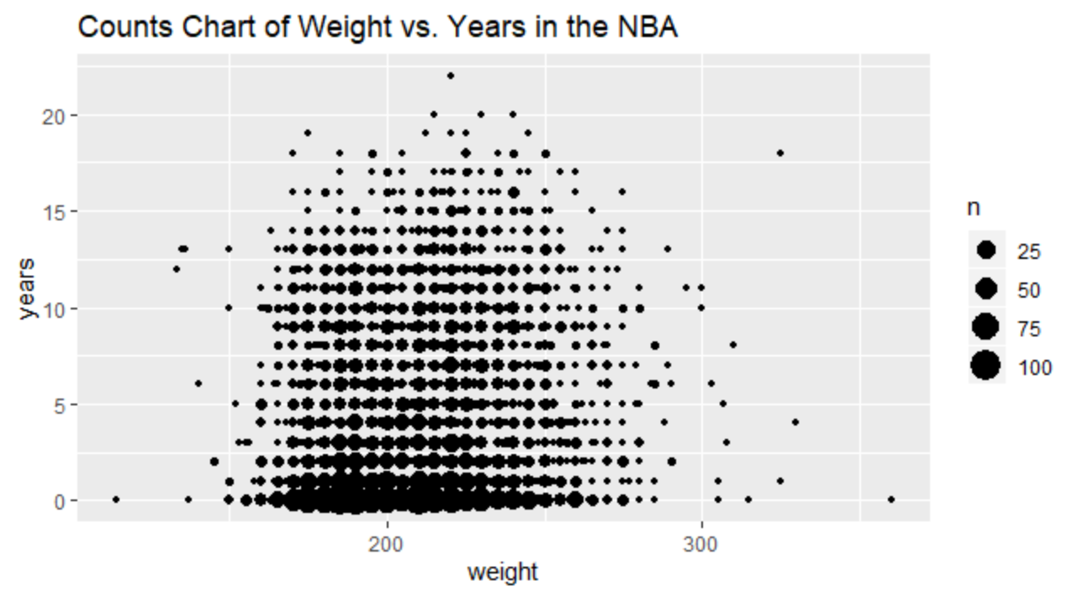
There may be an interesting boundary trend where increasing weight over 250 lb. is correlated with a decrease in max years in the NBA (limited sample size). There is one notable outlier, Shaq!
Shaq
Notes:
#Years in the league
bball$years=bball$year_end-bball$year_start
bball %>% ggplot(aes(weight,years)) + geom_count() +
ggtitle("Counts Chart of Weight vs. Years in the NBA")

Slide 11
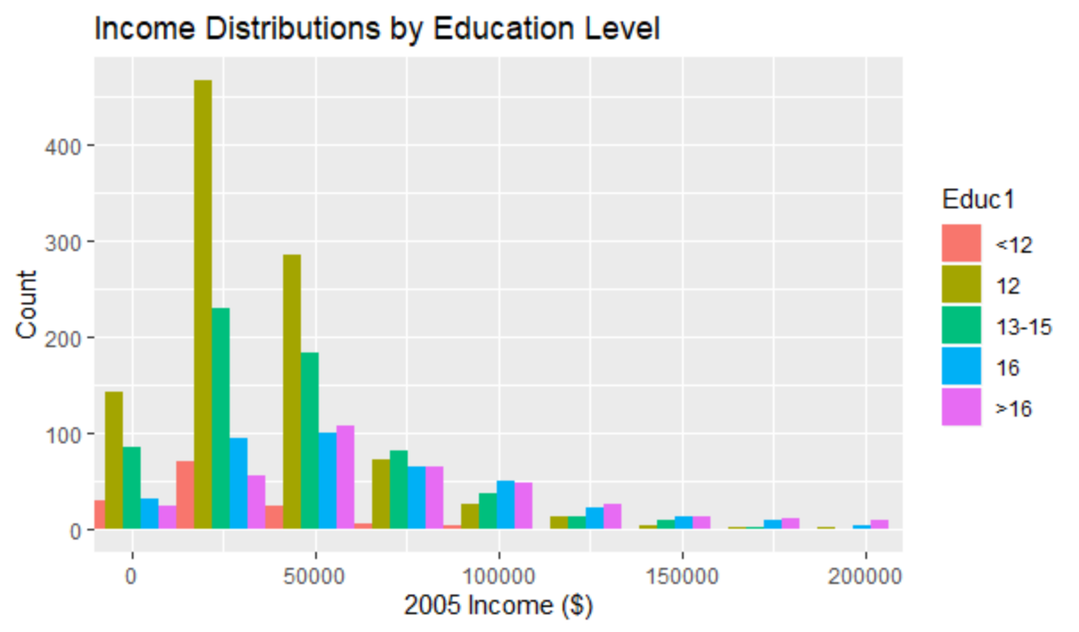
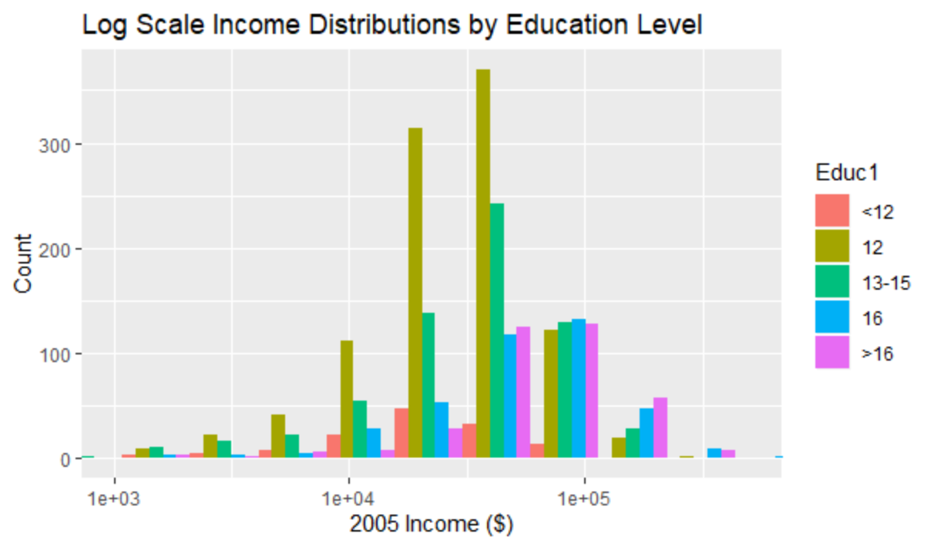
Median income appears to increase with Education Level
Notes:
Educ.Inc = read.csv('C:/Users/allep/OneDrive/Documents/MDS-6306-Doing-Data-Science/Unit 2/Education_Income.csv')
summary(Educ.Inc)
#Reorder Educ so >16 is after 16
Educ.Inc$Educ1 = factor(Educ.Inc$Educ, levels(Educ.Inc$Educ)[c(1,3:5,2)])
levels(Educ.Inc$Educ1)
Educ.Inc %>% ggplot(aes(x=Income2005,fill=Educ1)) + geom_histogram(position="dodge") + coord_cartesian(xlim=c(0,200000)) +
ggtitle("Income Distributions by Education Level") + xlab("2005 Income ($)") + ylab("Count")
#Log x scale
Educ.Inc %>% ggplot(aes(x=Income2005,fill=Educ1)) + stat_bin(position="dodge",bins=15) +
coord_cartesian(xlim=c(1000,500000)) + ggtitle("Log Scale Income Distributions by Education Level") +
xlab("2005 Income ($)") + ylab("Count") + scale_x_log10()

Slide 12
Takeaways and Questions
Takeaways
Rstudio’s viewer/browser didn’t work with plotly 3D plots. Troubleshooting this was time consuming but educational and I now have easy workarounds.
The maps package in R is awesome! I can’t wait to use this more.
Questions
Is there a way to plot histogram distributions in ggplot with proportion rather than count? The only thing I could find was geom_density which smooths the distribution. There may be something buried in the stat option as well that I didn’t see.

